Slide 1
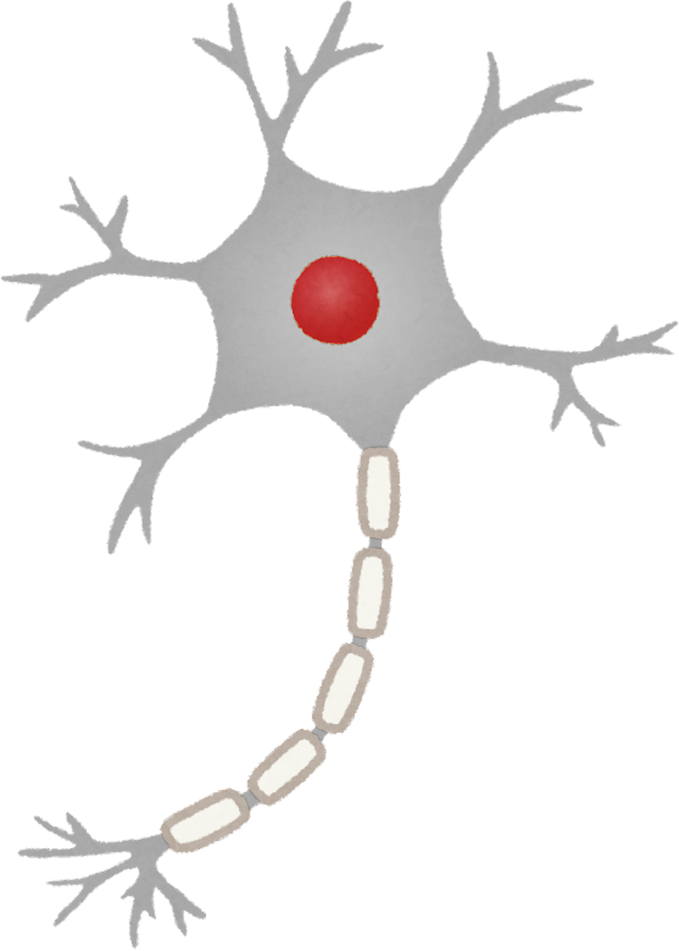
RECOMMENDER SYSTEM
NEURAL COLLABORATIVE FILTERING–BASED RECOMMENDER SYSTEM
  Python | PyTorch | Neural CF
  Objective: Personalized recommendations using deep learning
HAMNA FATIMA (23K-0916)
LAYQA FATIMA (23K-0572)

Slide 2



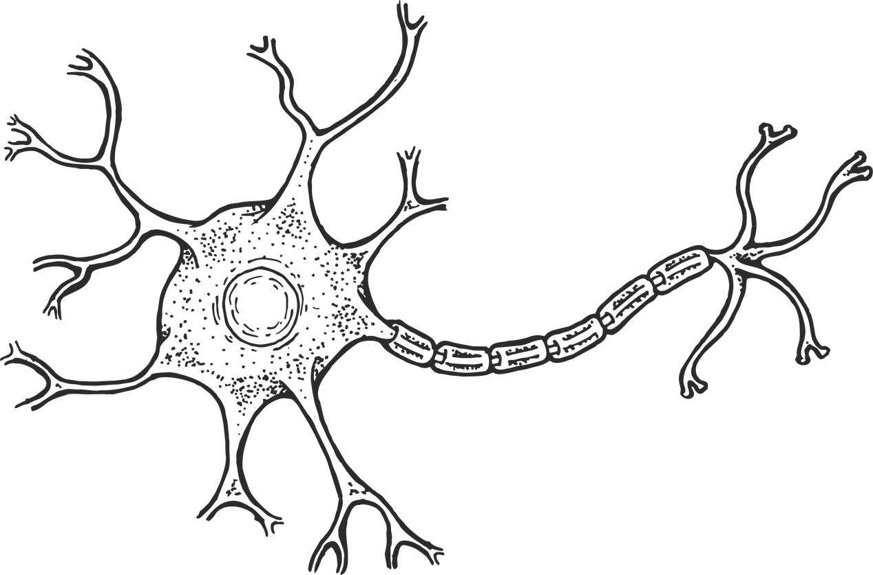
RECOMMENDER SYSTEM
PROJECT OVERVIEW
What is implemented
  Neural Collaborative Filtering–based Recommender System
  End-to-end pipeline: data → model → training → recommendation
Formula
class NeuralRS(nn.Module):
def __init__(self, num_users, num_items):
super().__init__()
Code Snip

Slide 3

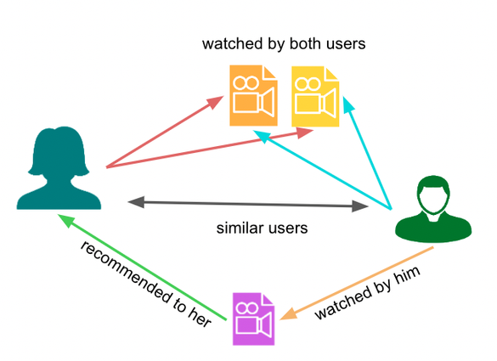
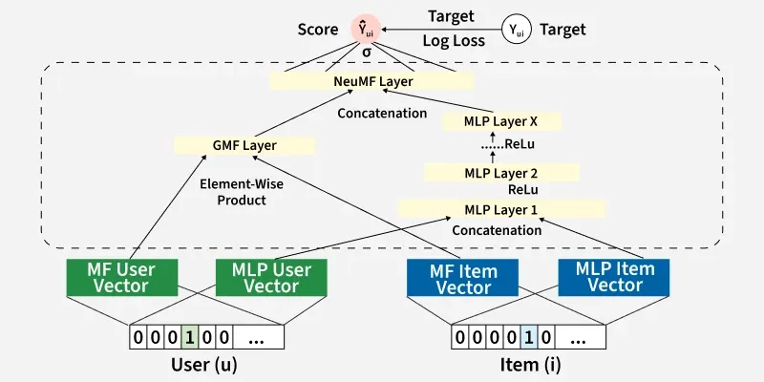

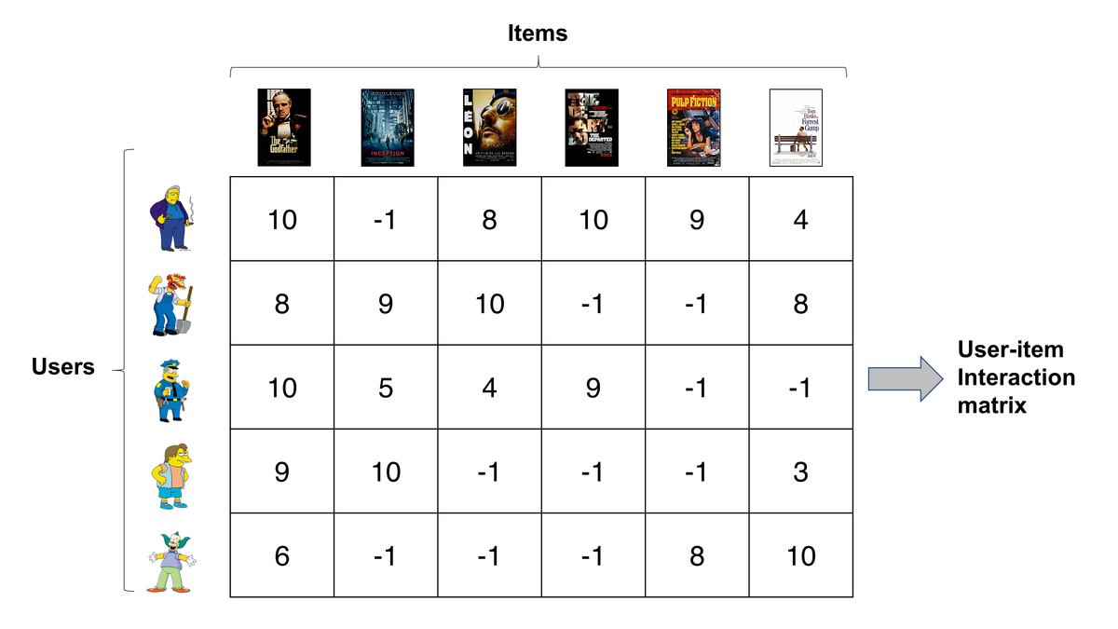
COLLABORATIVE FILTERING CONCEPT
Formula
Code
class RatingsDataset(Dataset):
def __init__(self, users, items, labels):
self.users = torch.LongTensor(users)
self.items = torch.LongTensor(items)
self.labels = torch.FloatTensor(labels)

Slide 4

RECOMMENDER SYSTEM
INPUT REPRESENTATION & INTERACTION SIGNAL
  User ID (u)
  Item ID (i)
  Interaction label (yᵤᵢ)
Model Input
Training Example
def __getitem__(self, idx):
return self.users[idx], self.items[idx], self.labels[idx]
Code (Dataset Access)
Interaction Signal (Learnable Pattern)
labels = (users % 5 == items % 5).astype(int)

Slide 5

RECOMMENDER SYSTEM
Project Components
  Dataset class → prepares training data
  Neural CF model → learns user–item interactions
  Training loop → optimizes model parameters
  Recommendation function → generates Top-K items
SYSTEM COMPONENTS & DATA FLOW
Data Flow
User–Item Data → Model Training → Personalized Recommendations
Code (Structure)
RatingsDataset
NeuralRS
training loop
recommend_items()

Slide 6
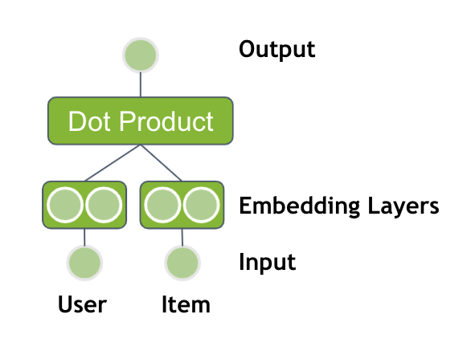
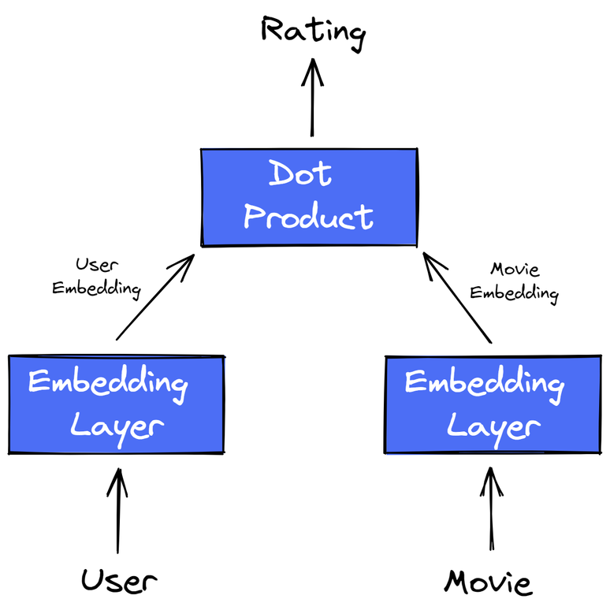
RECOMMENDER SYSTEM
EMBEDDING LAYER
What embeddings do
  Convert IDs into dense vectors
  Capture latent preferences
Formula
Code Snip
self.user_embedding = nn.Embedding(num_users, 32)
self.item_embedding = nn.Embedding(num_items, 32)

Slide 7


RECOMMENDER SYSTEM
NEURAL COLLABORATIVE FILTERING (MLP)
How NCF works
  Combine user & item embeddings
  Pass through neural network
Formula
x = torch.cat([u, i], dim=1)
output = self.mlp(x)
Code Snip

Slide 8
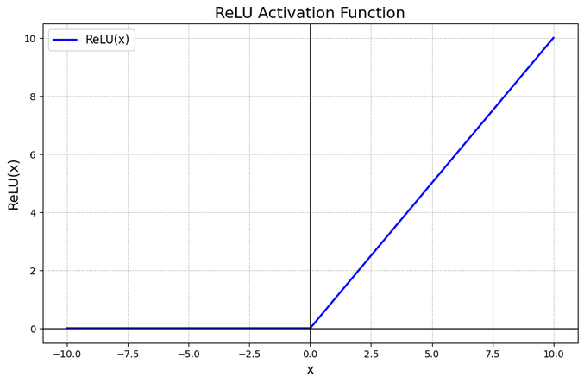

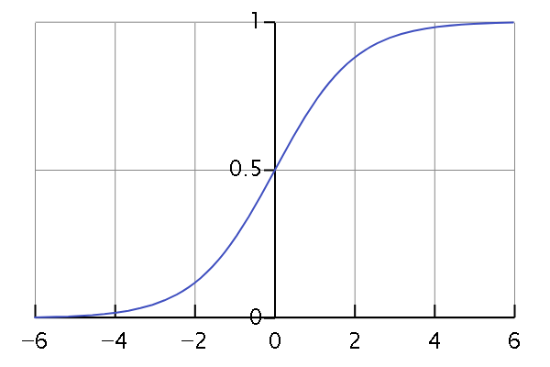

RECOMMENDER SYSTEM
ACTIVATION FUNCTIONS
Why used
  ReLU → non-linearity
  Sigmoid → probability
Relu
Sigmoid
Code Snip
nn.ReLU()

Slide 9

RECOMMENDER SYSTEM
LOSS FUNCTION
What is optimized
  Binary interaction prediction
Formula
criterion = nn.BCEWithLogitsLoss()
loss = criterion(logits, label)
Code Snip

Slide 10


RECOMMENDER SYSTEM
TRAINING & RECOMMENDATION OUTPUT
Training
  Backpropagation
  Adam optimizer
Recommendation
  Mask seen items
  Top-K ranking
Gradient Descent
scores[seen_items] = -1e9
top_items = torch.topk(scores, 5)
Code Snippet

Slide 11

RECOMMENDER SYSTEM
Output
  Ranked item list per user
  Learned user preferences
FINAL OUTPUT & CONCLUSION
Code Snippet
print(recommended)
Connclusion
  Fully functional Neural RS
  Learns non-linear interactions
  End-to-end implementation.
This completes the recommender system

Slide 12


THANK
YOU.

